Slide 1
How to Change the Price of an Existing Item
See the last slide for a video tutorial.

Slide 2
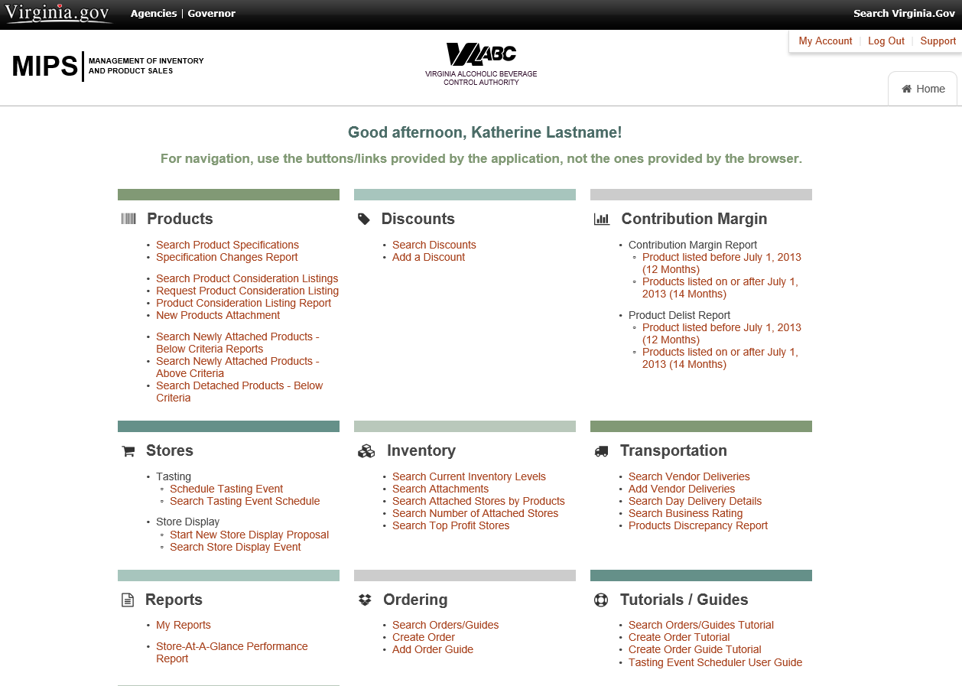
This tutorial will instruct you how to make a price change for a listed product.
You will start at the Virginia ABC MIPS homepage.

Slide 3
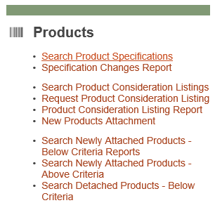
On the homepage, under the Products category select “Search Product Specifications”.

Slide 4
You have navigated to the Product Search page. You can search for individual products by code or label, or you can search by vendor in the drop-down list.

Slide 5
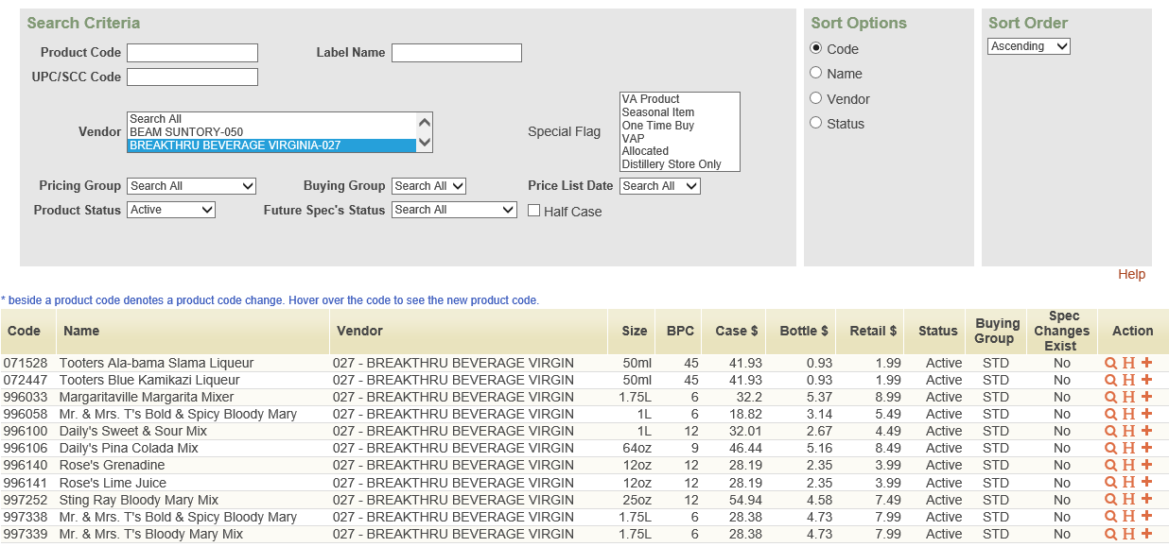
Example: Listed above is a search for active products for Breakthru Beverage. For each product you will have three available actions: View, History or Add Spec Change.

Slide 6
To make a price change, Select to make a Spec Change.

Slide 7
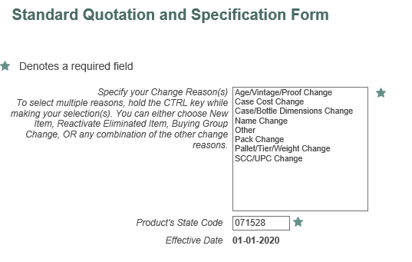
After finding the product and selecting to make a spec change, you will be brought to this screen. Here, you will want to select “Case Cost Change” in order to change the price. Hit Next.

Slide 8
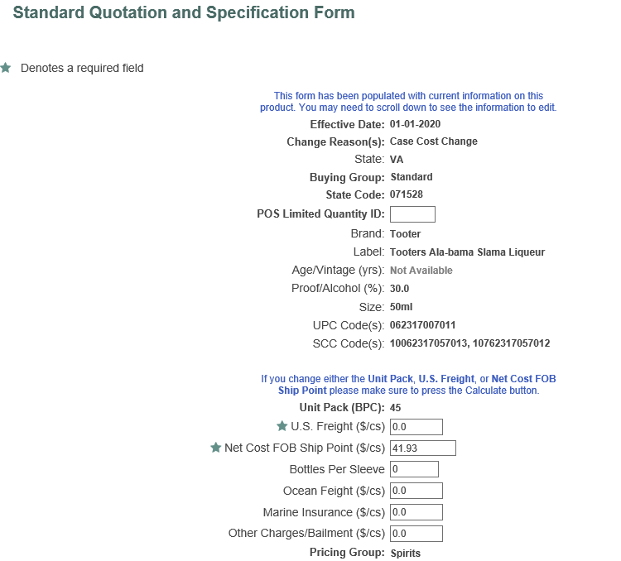
For this specification form, please fill out all fields appropriately. Click Submit to calculate a retail bottle price before advancing.
The POS Limited Quantity should be left blank.
The US Freight should be $0.00 unless the shipping is not pre-calculated into the price.
The Net Cost is determined by the Vendor.
The Bottles per Sleeve, Ocean Freight, Marine Insurance and Other charges should be left blank.

Slide 9
After calculating a new price, Virginia ABC will have to review the pending price change request. If we are missing any information or the request was filled out incorrectly, we will contact you.

Slide 10
Video Tutorial

Slide 11
Questions?
If you have any troubles or questions with this process, please reach out to the following:
ProductMaster@abc.virginia.gov
Robin Fox, robin.fox@abc.virginia.gov, (804) 213-4524
Todd Neeter, Todd.Neeter@abc.virginia.gov, (804) 213-4528
John Shiffer, John.Shiffer@abc.virginia.gov, (804) 213-4522

